Slide 1
ENHANCING ON-CHIP NETWORK PREDICTIONS WITH ADVANCED AI TECHNIQUES
Progress Presentation for Research Project Module 5E1
Lingyu Gong
Trinity College Dublin
Supervisor: Dr. Libin Mathew
Date 23/05/2024
Notes:
Good morning, everyone.
Today, I am here to present my progress on the project titled "Enhancing On-Chip Network Prediction with Advanced AI Techniques." It is an honor to share this work with you. My supervisor for this project is Doctor Libin Mathew.

Slide 2


Contents
Project Overview
State of the Art
Progress Review
Future Plan
Notes:
Outline of Presentation
My presentation is divided into four main parts:
Project Overview
State of the Art
Progress Review
Future Plan

Slide 3
Part 1
Project Overview
Notes:
Let's start with an overview of the project.

Slide 4
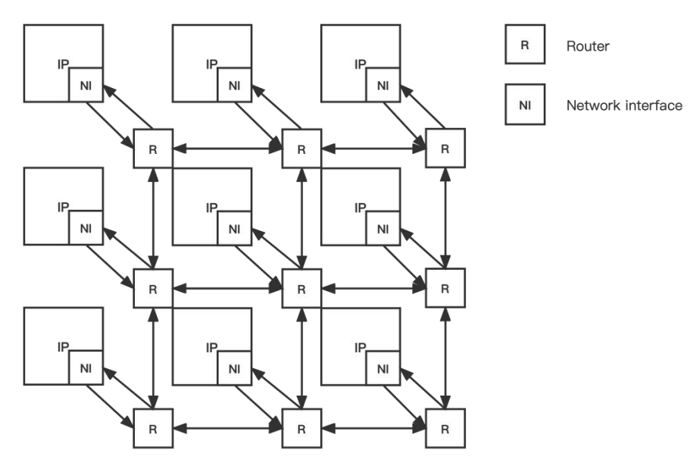
Problem Description
Network-on-Chip (NoC): integrated circuits designed for network-based communication subsystems
Consists of multiple sections of links and routers
The Network Interface (NI) module converts data packets from various IP blocks for transmission across the network
Scalability, High Performance, Low Latency, Power Efficiency, Design Flexibility
Fig 1: NoC structure diagram
Notes:
This project focuses on the Network-on-Chip (NoC), a critical communication subsystem integrated into chips, predominantly used in system-on-chip designs. The NoC is complex, comprising a network of wires and routers arranged in a grid layout, as depicted in Figure 1. A key component of the NoC is the network interface module, which converts data packets from various IP blocks for efficient transmission across the network. The importance of NoC stems from its scalability, high performance, low latency, power efficiency, and design flexibility. These benefits drive continuous research and development, leading to significant technological advancements.

Slide 5
Project Objective
Optimize Prediction of NoC Parameters:
Use AI techniques to accurately predict key performance parameters of Networks-on-Chip (NoCs) for mobile computing.
Improve design accuracy and reduce development time and cost.
Enhance NoC Performance:
Continuously improve NoC performance to meet future high-performance challenges.
Utilize Deep Neural Networks and Convolutional Neural Networks to predict performance under various conditions.
Reduce Simulation Reliance:
Minimize reliance on exhaustive simulations by using AI for performance prediction.
Accelerate the NoC design process.
Implement AI Algorithms:
Develop and optimize AI algorithms to predict NoC performance metrics such as throughput and latency.
Enhance operational efficiency and reduce power consumption.
Support Mobile Computing:
Provide technical support for mobile computing performance improvement.
Contribute practical insights and new methodologies for on-chip network design.
Notes:
The core objective of my project is to enhance NoC technology using advanced AI techniques. Specifically, I aim to improve the performance and design flow of NoCs to meet future high-performance computing demands. This involves optimizing predictive models, improving performance metrics, reducing reliance on traditional simulation methods, implementing innovative AI algorithms, and supporting the evolution of mobile computing. These efforts contribute to improving the efficiency and adaptability of NoC systems.

Slide 6
Part 2
State of the Art
Notes:
Now, let's move to the state of the art in this field.

Slide 7
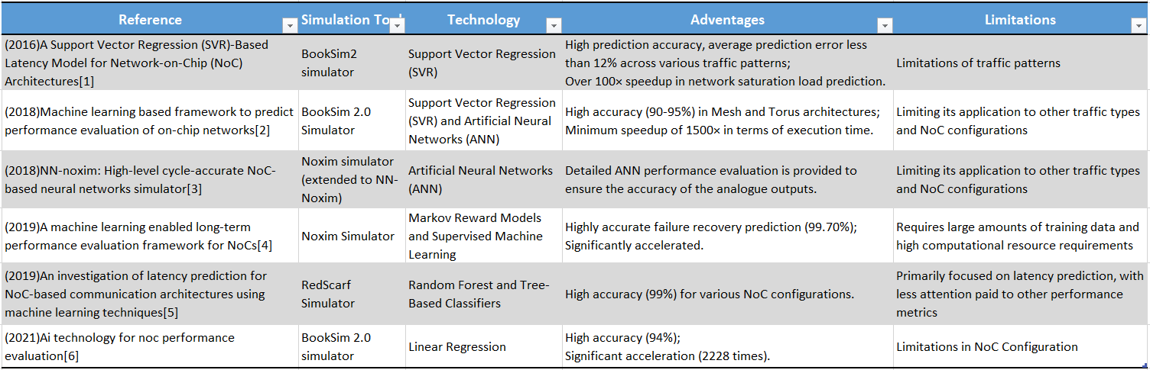
Existing technologies and Limitations
Advantages:
Achievement of high prediction accuracy (95%)
Significantly increase the speed of prediction
Limitations:
Limited to specific NoC configurations
High demand for computing resources
[1] Qian Z L, Juan D C, Bogdan P, et al. A support vector regression (SVR)-based latency model for network-on-chip (NoC) architectures[J]. IEEE Transactions on Computer-Aided Design of Integrated Circuits and Systems, 2015, 35(3): 471-484.
[2] Kumar A, Talawar B. Machine learning based framework to predict performance evaluation of on-chip networks[C]//2018 Eleventh International Conference on Contemporary Computing (IC3). IEEE, 2018: 1-6.
[3] Chen K C, Wang T Y. NN-noxim: High-level cycle-accurate NoC-based neural networks simulator[C]//2018 11th International workshop on network on chip architectures (NoCArc). IEEE, 2018: 1-5.
[4] Hou J, Han Q, Radetzki M. A machine learning enabled long-term performance evaluation framework for NoCs[C]//2019 IEEE 13th International Symposium on Embedded Multicore/Many-core Systems-on-Chip (MCSoC). IEEE, 2019: 164-171.
[5] Silva J, Kreutz M, Pereira M, et al. An investigation of latency prediction for NoC-based communication architectures using machine learning techniques[J]. The Journal of Supercomputing, 2019, 75(11): 7573-7591.
[6] Bhowmik B, Hazarika P, Kale P, et al. Ai technology for noc performance evaluation[J]. IEEE Transactions on Circuits and Systems II: Express Briefs, 2021, 68(12): 3483-3487.
Notes:
I have summarized previous works in a table that highlights the references, simulation tools used, and AI technologies implemented. The table also outlines the advantages and limitations of these works. For example, previous works achieved high accuracy, ranging from 88% to 95%, in predicting specific NoC parameters and significantly sped up the prediction process. However, they are often limited to specific NoC configurations and require high computing resources. My project aims to use a lightweight model to achieve higher prediction accuracy and include more evaluation indicators.
For the simulator, most researchers use BookSim2, a robust NoC simulator. It supports various network topologies, routing algorithms, and traffic patterns, allowing for extensive large-scale network simulations. Users can customize parameters such as traffic patterns and buffer sizes and manage the simulator through configuration files and a command-line interface. I have chosen BookSim2 as the simulator for this project.

Slide 8
Part 3
Progress Review
Notes:
In this section, I will review my progress, explain the work completed, and share the results obtained so far.

Slide 9
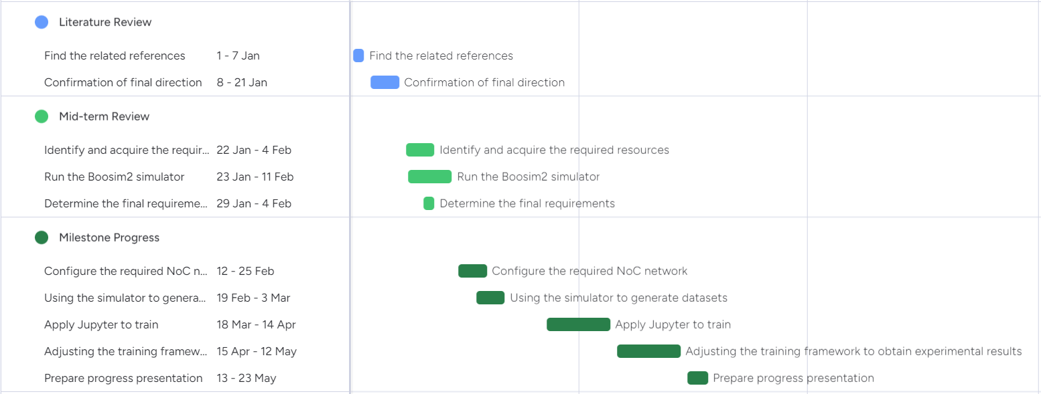
Initial goals and milestones
Fig 2: Gantt chart of the project implementation plan
Notes:
Figure 2 shows my initial goals and milestones. I had to make a few changes due to an exam week and some course final project submissions, which pushed the project timeline back a bit. This image represents the true and complete timeline.

Slide 10
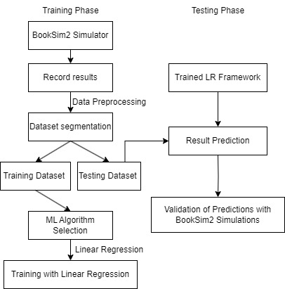
Prediction Framework
Figure 3 outlines the process used to develop the proposed predictive framework.
1. Training Phase:
BookSim2 Simulation: Generate data.
Record Results: Collect performance metrics from simulations.
Data Preprocessing: Clean and preprocess the collected data.
Dataset Segmentation: Split the data
ML Algorithm Selection: Choose a machine learning algorithm.
Linear Regression Training: Train the model.
2. Testing Phase:
Trained LR Framework: Utilize the trained linear regression model.
Result Evaluation: Validate predictions against new simulations.
Validation: Predicted results vs Actual simulation outcomes
Fig 3: Proposed LR Framework
Notes:
Figure 3 outlines the prediction framework of my project, divided into Training and Testing Phases. The Training Phase involves generating data using BookSim2, recording results, data preprocessing, segmenting the dataset, selecting an AI algorithm, and training the model using linear regression. The Testing Phase involves utilizing the trained linear regression model, validating predictions against new simulations, and evaluating the results.

Slide 11
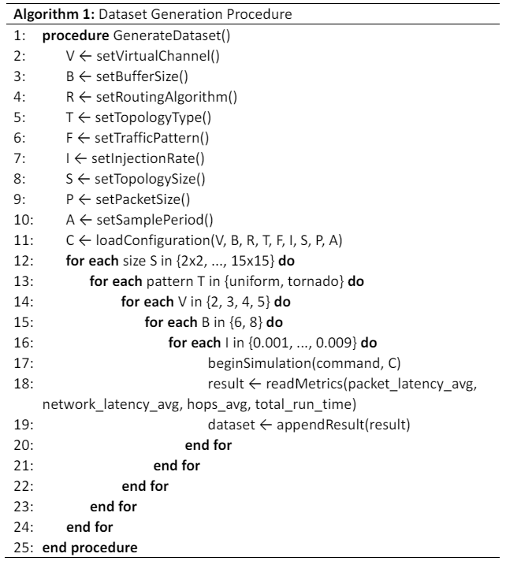
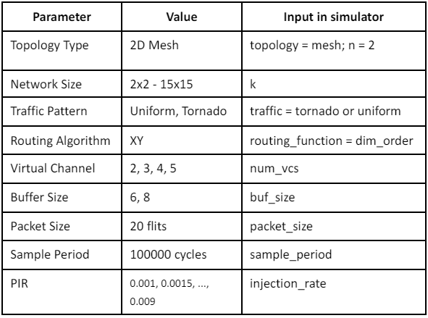
Data preparation
Dataset generation
Figure 4 shows the configuration details
Figure 5 is the process for dataset generation
Fig 4: The configuration details
Fig 5: Algorithm for dataset generation
Notes:
For dataset preparation, I used BookSim2 to generate the required data. Figure 4 shows the configuration details, and Figure 5 illustrates the pseudocode for dataset generation.

Slide 12
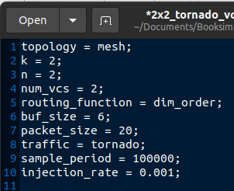
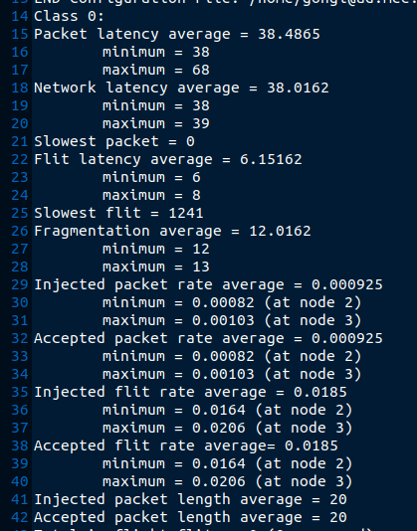
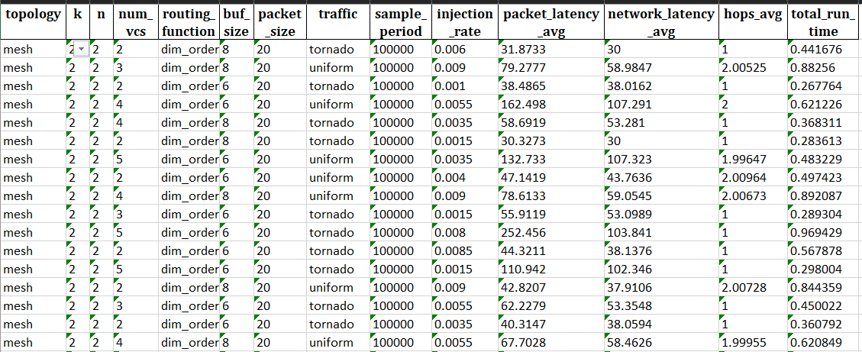
Data generation
This page shows the detailed results achieved from the simulations.
Figure 6 illustrates an example of a configuration file used in one of the simulations.
Figure 7 provides an example of a result file
Figure 8 shows part of the dataset abstracted from all the result files
Fig 6: Example of a configuration file
Fig 8: Part of datasets
Fig 7: Example of a result file
Notes:
Figures 6, 7, and 8 present examples of a configuration file, a result file, and part of the dataset abstracted from the result files, respectively.

Slide 13
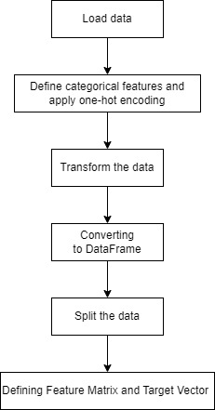
Data preparation
Data preprocessing:
Loading Data
Read dataset from Excel file
Check data types
Defining and Encoding Categorical Columns
Identify categorical columns (topology, routing function, traffic patterns)
Convert categorical data using One-Hot Encoding
Applying Column Transformer
Apply One-Hot Encoding to categorical columns
Keep numerical columns unchanged
Converting to DataFrame
Convert processed data to Pandas DataFrame
Verify encoded data types
Data Splitting
Split dataset into training and testing sets based on remainder__k value
Defining Feature Matrix and Target Vector
Feature Matrix (X): All columns except prediction targets
Target Vector (y): NoC performance parameters to be predicted
Fig 9: Process of data preprocessing
Notes:
Data preprocessing is crucial for the training phase. I have summarized this process in a flow chart and described the steps in detail. These steps include loading data, checking data types, applying one-hot encoding to categorical data, converting the data into a Pandas DataFrame, splitting the dataset into training and testing sets, and defining the feature matrix and target vector.

Slide 14
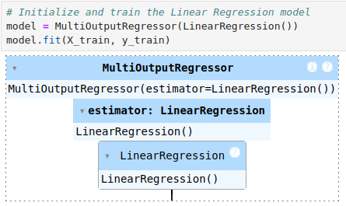
AI Model Selection and Training
1. Model Selection
Linear Regression[1]:
Chosen for its simplicity and interpretability
Suitable for predicting continuous numerical values
2. Model Initialization and Training
MultiOutputRegressor with Linear Regression:
Handles multiple target variables simultaneously
Uses Linear Regression for each target variable
Fig 10: Linear Regression Training Model
[1] Bhowmik B, Hazarika P, Kale P, et al. Ai technology for noc performance evaluation[J]. IEEE Transactions on Circuits and Systems II: Express Briefs, 2021, 68(12): 3483-3487.
Notes:
For AI model selection and training, I chose linear regression due to its simplicity and interpretability, making it suitable for predicting continuous values. I used a MultiOutputRegressor with linear regression to handle multiple target variables simultaneously.

Slide 15



Model Evaluation Metrics
1. Mean Squared Error (MSE)
Definition: Measures the average squared difference between actual and predicted values.
Formula:
Purpose: Indicates how close the predictions are to the actual values; lower values signify better model performance.
2. R-squared (R²)
Definition: Represents the proportion of the variance in the dependent variable that is predictable from the independent variables.
Formula:
Purpose: Shows the explanatory power of the model; values closer to 1 indicate a better fit.
3. Variance
Definition: Measures the spread of the data points.
Formula:
Purpose: Indicates the extent to which data points differ from the mean value; used to assess the error’s variability.
4. Accuracy
Definition: A measure of how close the predictions are to the actual values, often defined in various ways depending on context.
Formula:
Purpose: Provides a normalized measure of prediction quality; values closer to 1 imply higher accuracy.
Notes:
Model evaluation metrics include Mean Squared Error (MSE), R-squared (R²), Variance, and Accuracy. These metrics help assess the quality of my model. The formulas for these metrics are well-known in deep learning evaluation, so I will skip the details here.

Slide 16
Model Visualization
Actual vs. Predicted Values:
Line plots showing the comparison.
Present a comprehensive visualization comparing the actual values with the predicted values for four different NoC (Network-on-Chip) performance metrics. Each subplot corresponds to a different performance metric, allowing for a clear and detailed comparison.
Error Distribution:
Histograms of errors for each target variable.
Visualize the distribution of prediction errors for four different NoC (Network-on-Chip) performance metrics. These histograms provide insights into the accuracy and reliability of the model's predictions by showing how the errors are distributed.
Notes:
For model visualization, I used line plots to compare actual and predicted values for different NoC performance metrics and histograms to analyze error distribution.

Slide 17
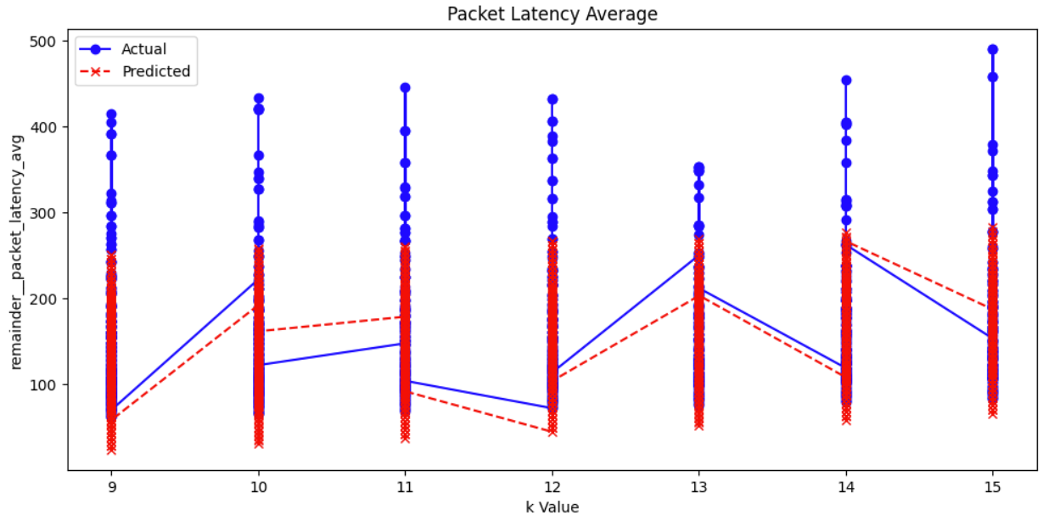
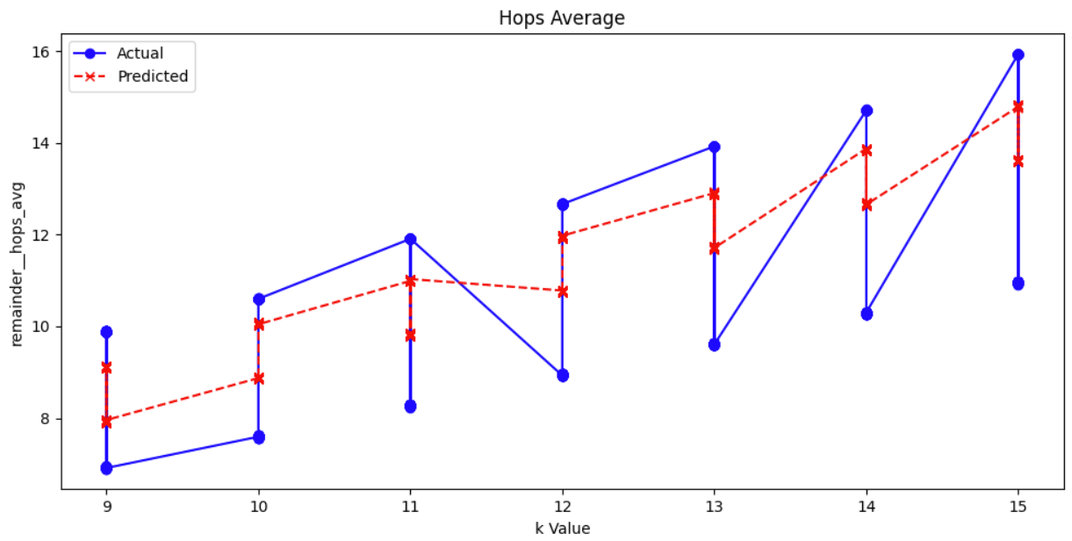
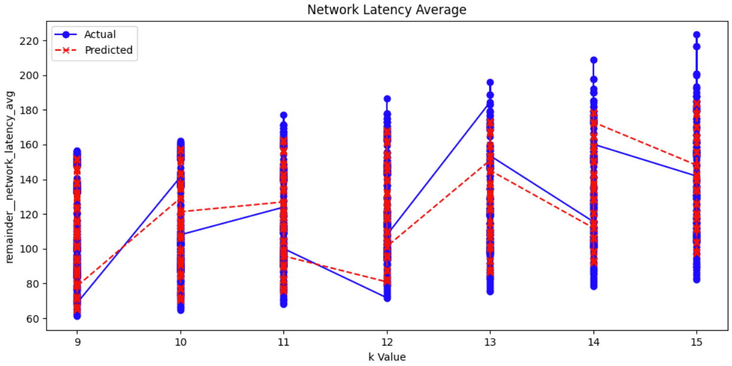
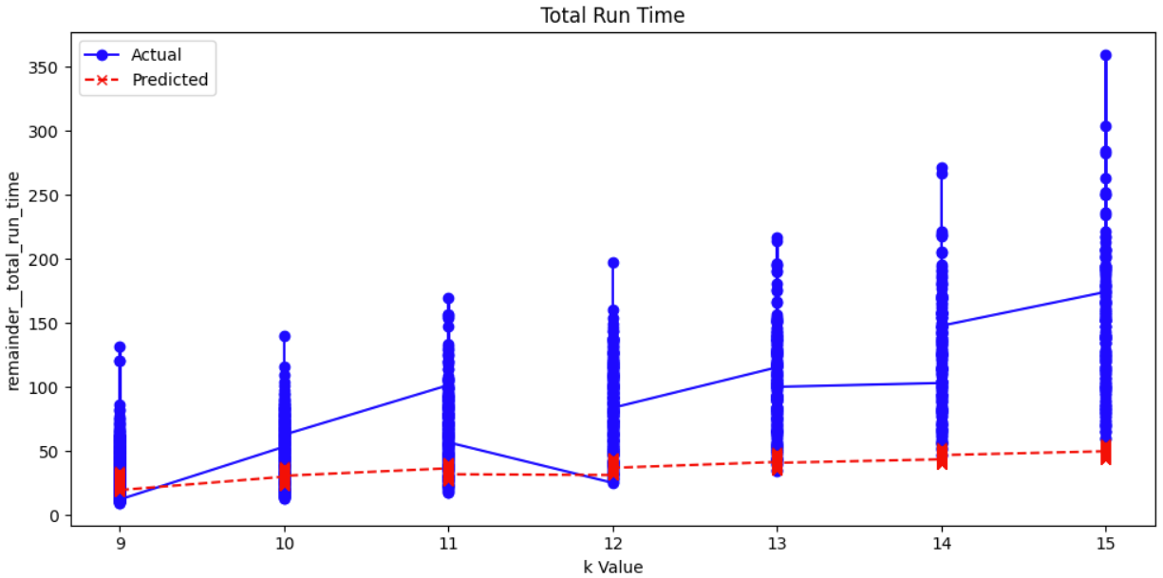
Projected results
Notes:
The main prediction parameters are Packet Latency Average, Hops Average, Network Latency Average, and Total Run Time. The line plots show that the overall difference between actual and predicted values is relatively small, with similar trends. However, the performance for Hops Average is worse, and the overall time using the linear regression method is significantly faster.

Slide 18
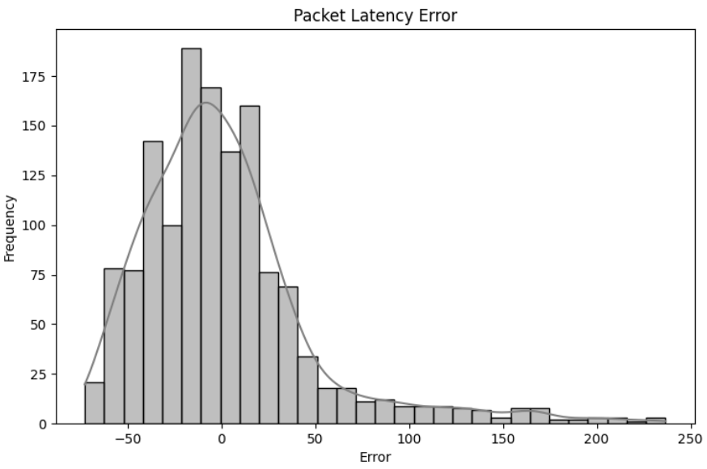
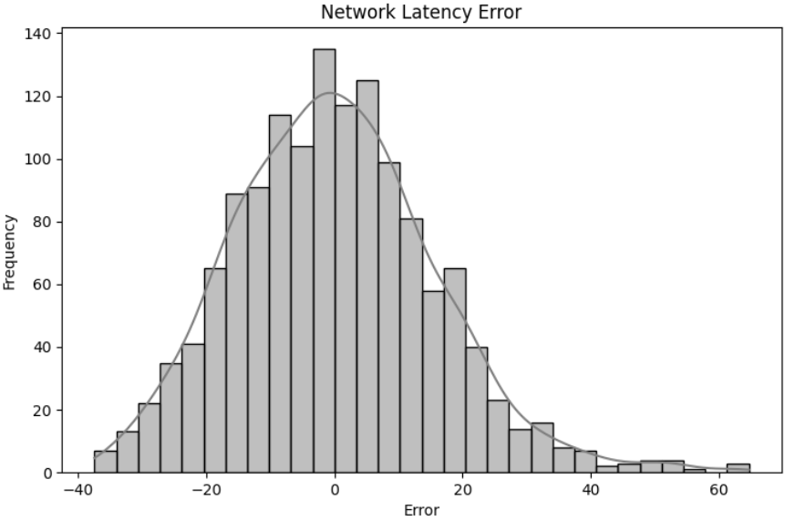
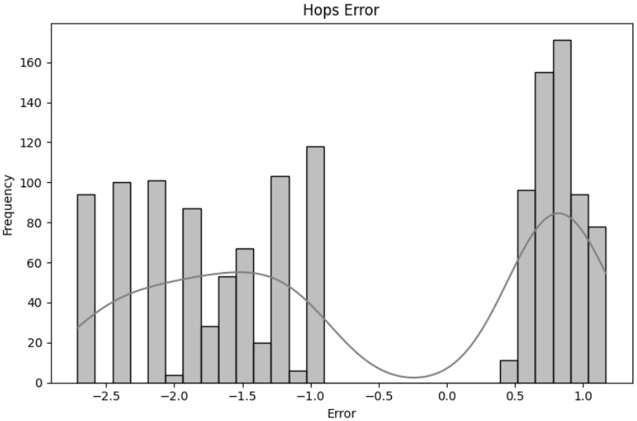
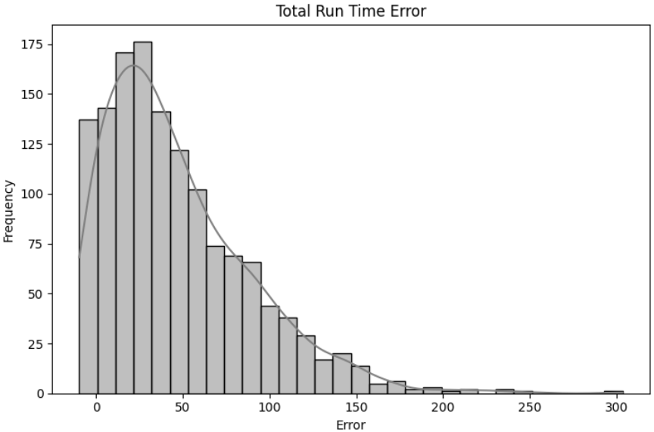
Error Analysis
Notes:
The error distribution analysis reveals that for packet delay, network delay, and time, most prediction errors are concentrated around zero, indicating high accuracy. However, for hop count, the errors are more dispersed, indicating some inaccuracy in predictions.

Slide 19
Challenges and Responses
Learning the NoC Network Configuration
Challenge: Booksim2 simulator, steep learning curve
Response: Documentation, tutorials, practice simulations
Long Simulation Run Time
Challenge: 4 days per simulation round, inefficiency
Response: Optimize parameters, parallel processing
Problems with Data Collection and Integration
Challenge: Data integration issues, organization
Response: Python scripts, automation, Excel formatting
AI Model Application and Validation
Challenge: New data application, validation vs. literature
Response: Thorough testing, benchmark comparison, fine-tuning
Notes:
Throughout the project, I encountered several challenges. Learning to configure the NoC network using BookSim2 was difficult due to its steep learning curve. My solution was to study the official documentation and practice simulations. The long simulation run time, taking about four days per round, was inefficient. I optimized parameters and used parallel processing to address this. Data collection and integration posed challenges, which I overcame by using Python scripts for automation and Excel for data formatting. Finally, applying and validating the AI model required thorough testing, benchmarking comparisons, and careful fine-tuning to ensure accuracy and reliability.

Slide 20
Summary of results achieved
Overall, the model achieves high accuracy levels across most metrics, particularly excelling in network latency predictions. However, there is potential for improvement in predicting hops and total run time to achieve even better performance.
Metric | Packet Latency | Network Latency | Hops | Total Run Time
MSE | 2202.17 | 244.83 | 2.24 | 3981.82
R² | 0.58 | 0.74 | 0.62 | -0.62
Variance | 5264.54 | 960.24 | 5.89 | 2454.33
Accuracy | 0.99 | 0.98 | 0.75 | 0.97
Table 1: Summary of assessment metrics
Notes:
In summary, the results show high accuracy levels across most metrics, particularly excelling in network latency predictions. However, there is room for improvement in predicting hops and total run time. I will continue to work on these aspects to achieve better performance.

Slide 21
Part 4
Future Plan

Slide 22
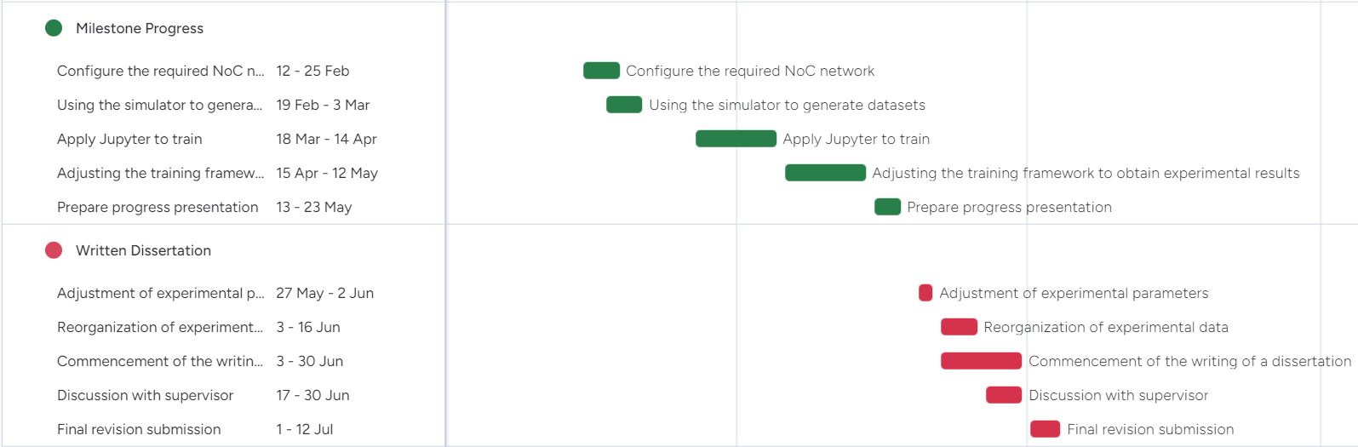
Follow-up Plans
Fig 11: Gantt chart of future plan
Notes:
In the future, my main focus will be on writing my thesis. However, I will continue to tweak relevant details, such as trying different training models like CNN or DNN to see if the results improve, and exploring why the prediction of hop averages is not accurate. I expect to have the first draft of my thesis finished by the end of June and will discuss it with my supervisor for further revisions.

Slide 23
Thank You
Notes:
That's all I have to report today. Thank you for your attention, and I look forward to your comments and discussions!

